Slide 1
LOS ANGELES POLICE DEPARTMENT BIG DATA ANALYTICS
Valerie Carisma
Alan Chan
Melissa Hamamoto
Andrew Lai
Medrik Minassian

Slide 2
ANALYZED DATA
Crime Data from 2010 to Present (414.3 MB)
LAPD Calls for Service 2010 (54.8 MB)
LAPD Calls for Service 2011 (53.3 MB)
LAPD Calls for Service 2012 (55 MB)

Slide 3
ANALYZED DATA
LAPD Calls for Service 2013 (53.85 MB)
LAPD Calls for Service 2014 (55.8 MB)
LAPD Calls for Service 2015 (57.2 MB)
LAPD Calls for Service 2016 (60.9 MB)

Slide 4
ANALYZED DATA
LAPD Calls for Service 2017 (62.8 MB)
LAPD Calls for Service 2018 up to 11/13/2018 (50.17 MB)
Traffic Collision Data from 2010 to Present (84.9 MB)
Vehicle and Pedestrian Stop Data 2010 to Present (586.6 MB)
TOTAL = 1,533.82 MB

Slide 5

EXPERIMENTAL SPECIFICATIONS
Hadoop version: Hadoop 2.7.1.2.4.2.0-258
Oracle Big Data Compute Edition : 5 nodes
Memory size: 150 GB
Storage: 678 GB
HDFS Capacity: 147 GB
CPU speed: 2.2Ghz E5-2699C v4

Slide 6



FLOWCHART OF DATA ANALYSIS
data.lacity.org

Slide 8
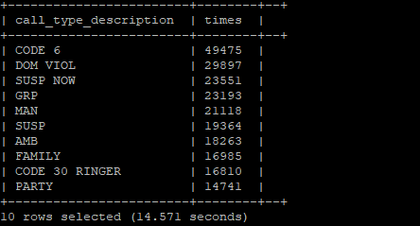

Slide 9
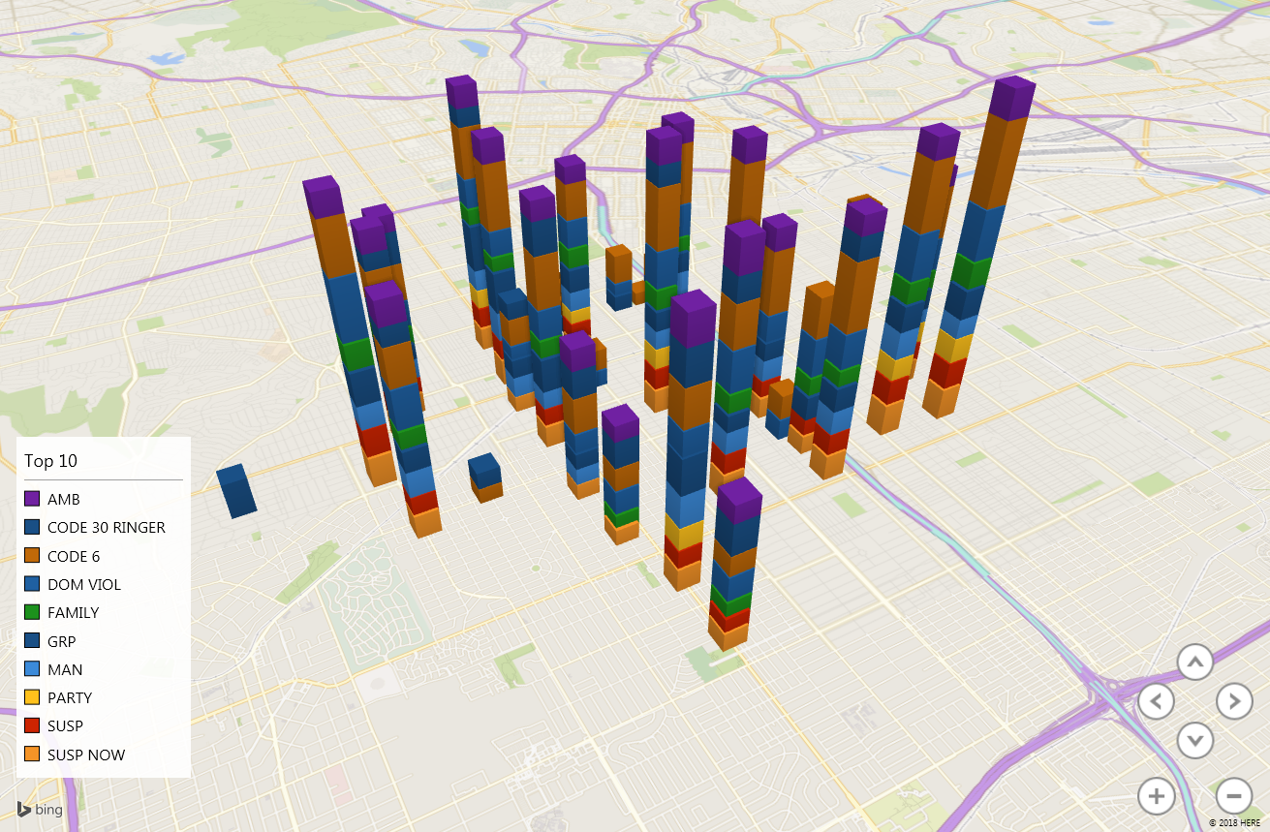

Slide 10
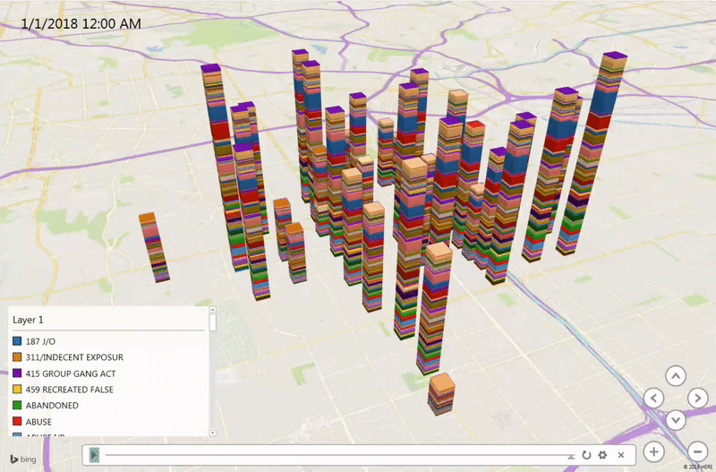
Service Calls at 77th Area

Slide 11
GitHub URL: https://github.com/mrandrewlai/Lapd-Crime-Data/blob/master/5200%20Project

Slide 12
Limitations
* Raw Data Collection process for the Calls for Service data by LAPD are not uniformed
* Latitude and Longitudes are combined in the same column

Slide 13
Summary
* Of all the geographical areas within LAPD’s jurisdiction, the 77th street Area has the most reported criminal activities.
* There is a significant decrease of criminal activities throughout the Los Angeles area since 2017.
* Most criminal activities occur during the afternoon, and there are less criminal activities in the morning.

Slide 14


Slide 15
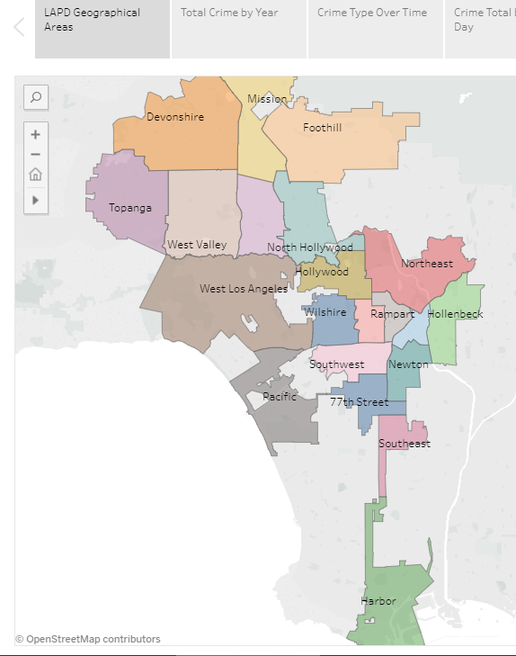
LAPD Geographical Areas

Slide 16
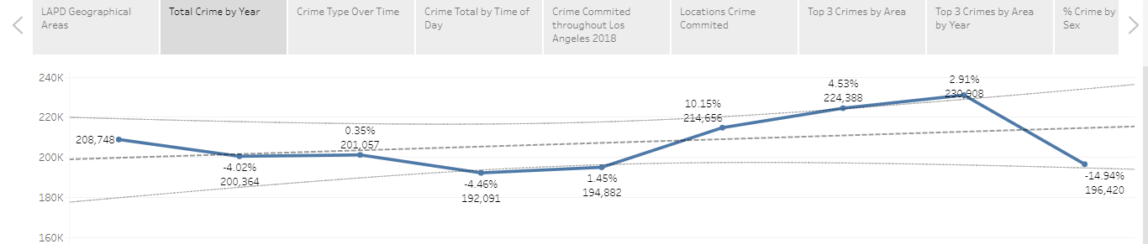
TOTAL CRIME BY YEAR

Slide 17
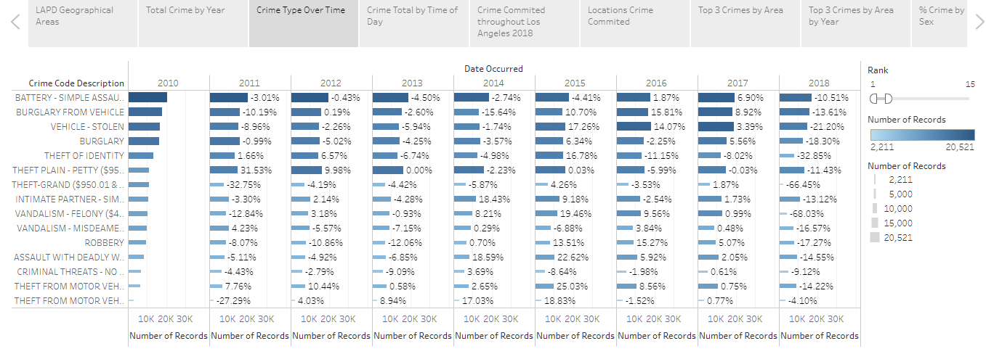
Crime Type over Time

Slide 18
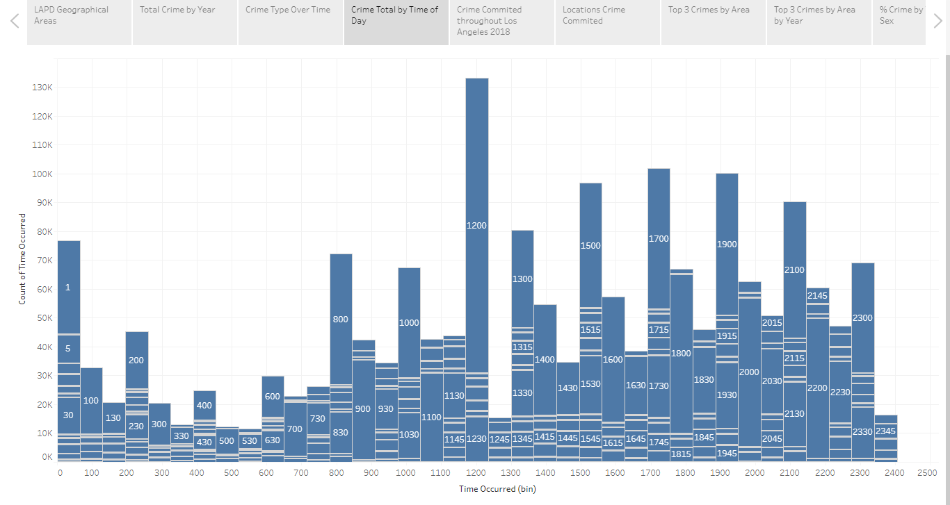
Crime Total by Time of Day

Slide 19
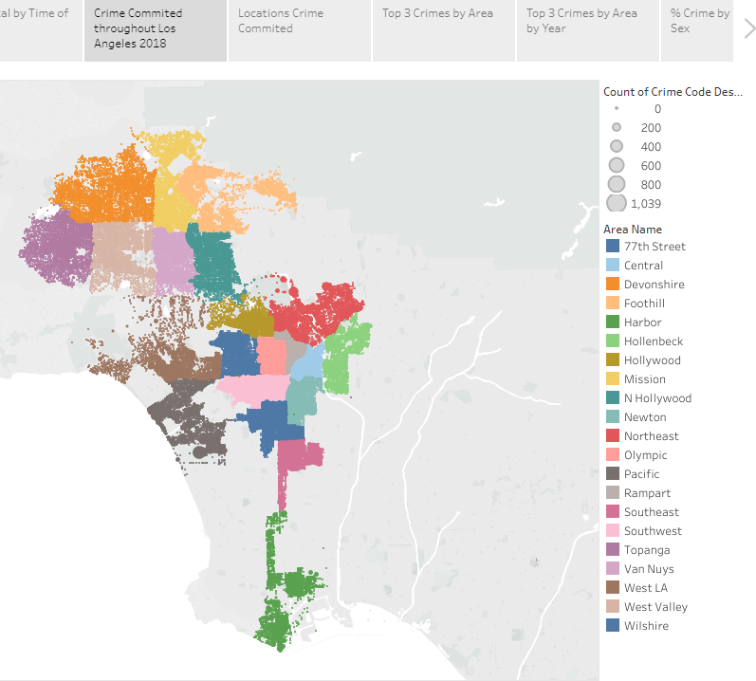
Crime Committed 2018

Slide 20
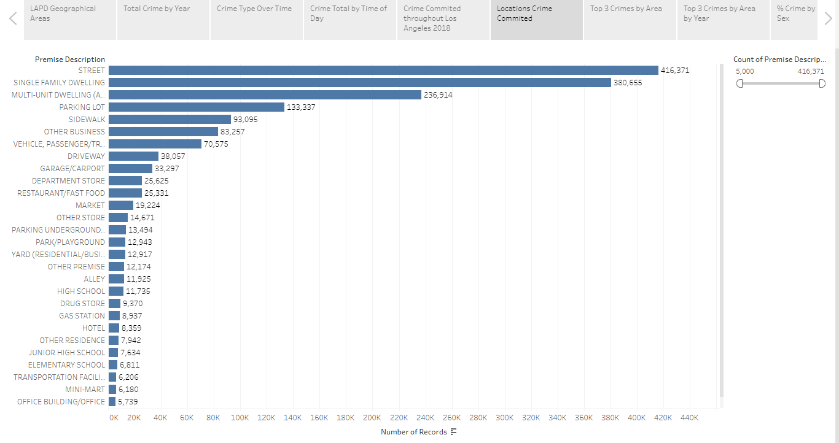
Locations of Criminal Activity

Slide 21
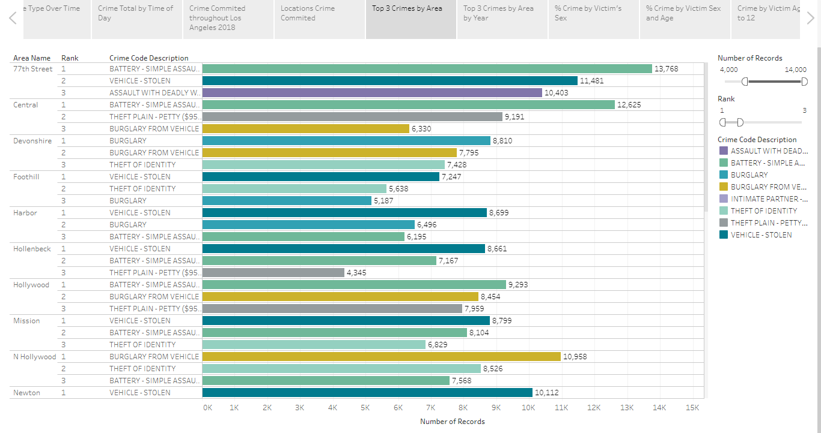
Top 3 Crimes by Area

Slide 22
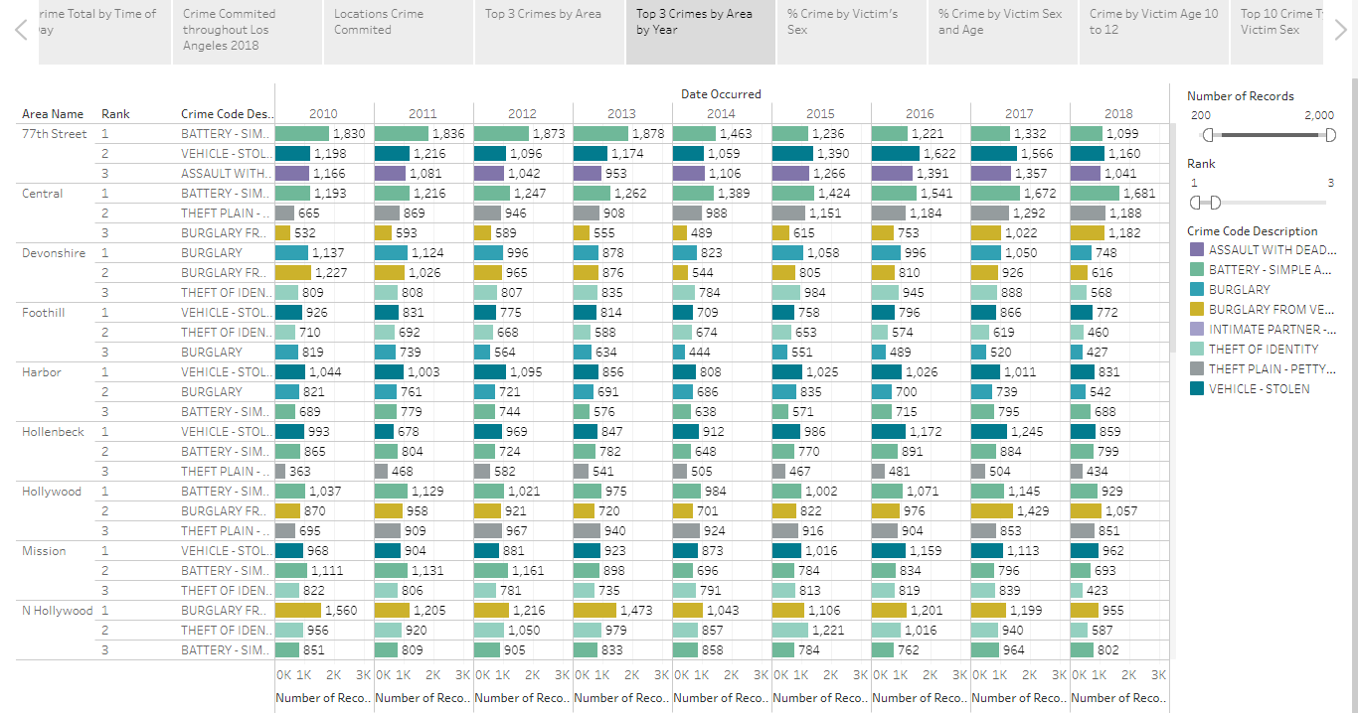
Top 3 Crimes by Area per Year

Slide 23
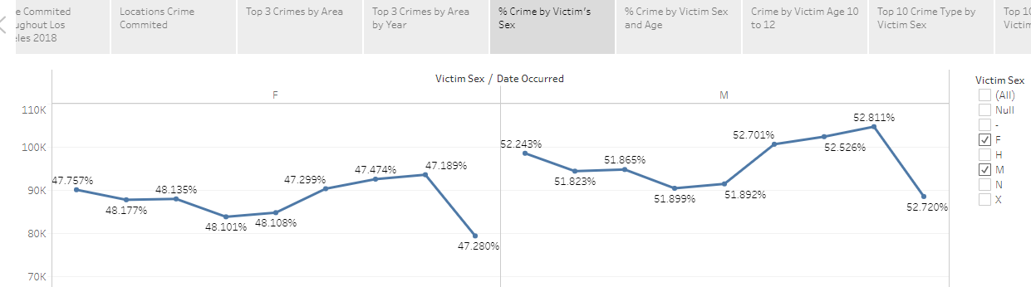
Crime Percentage by Victim’s Sex

Slide 24
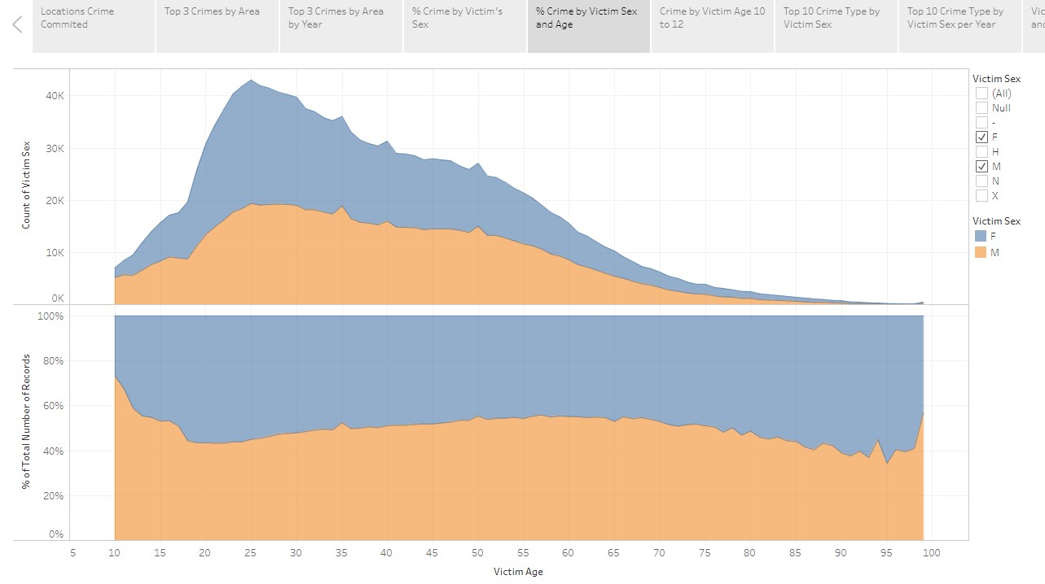
Crime Percentage by Victim Sex & Age

Slide 25
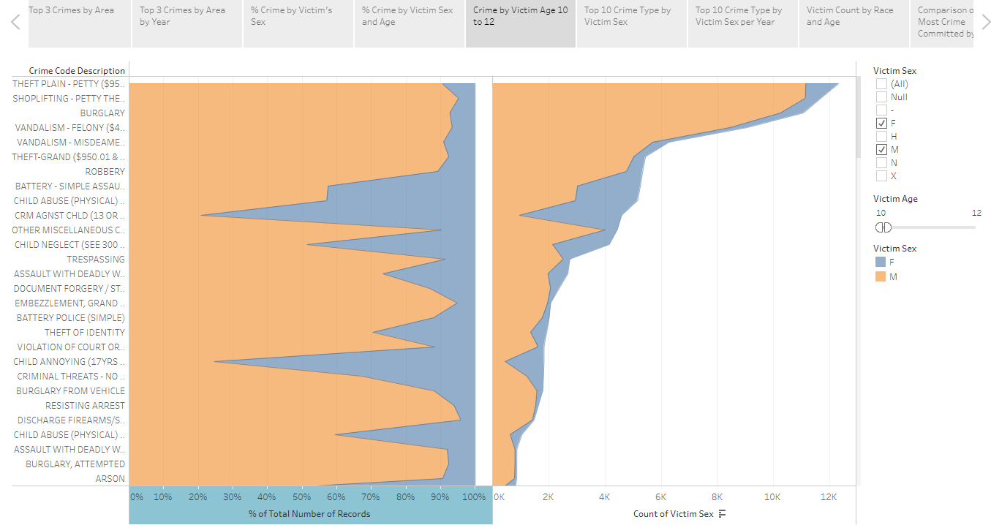
Crime towards Victims ages 10-12

Slide 26
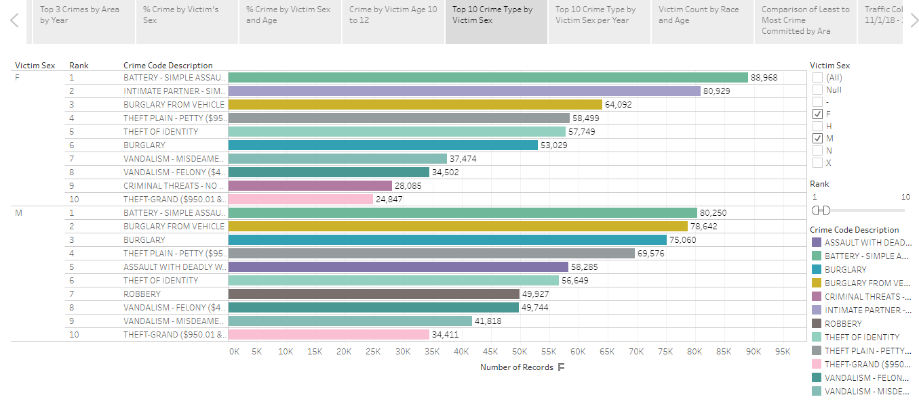
Top 10 Crime Type by Victim’s Sex

Slide 27
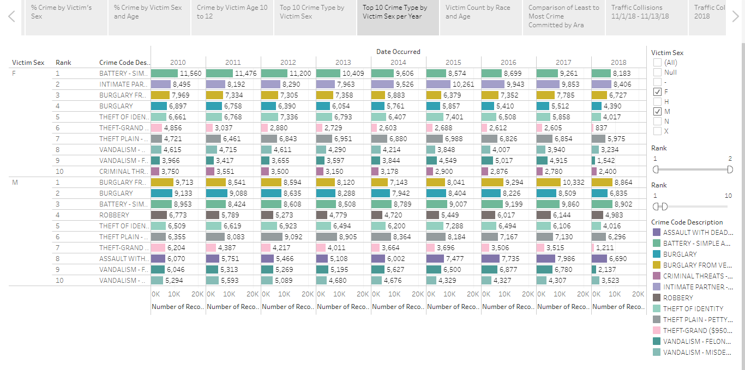
Top 10 Crime Type by Victim’s Sex per Year

Slide 28
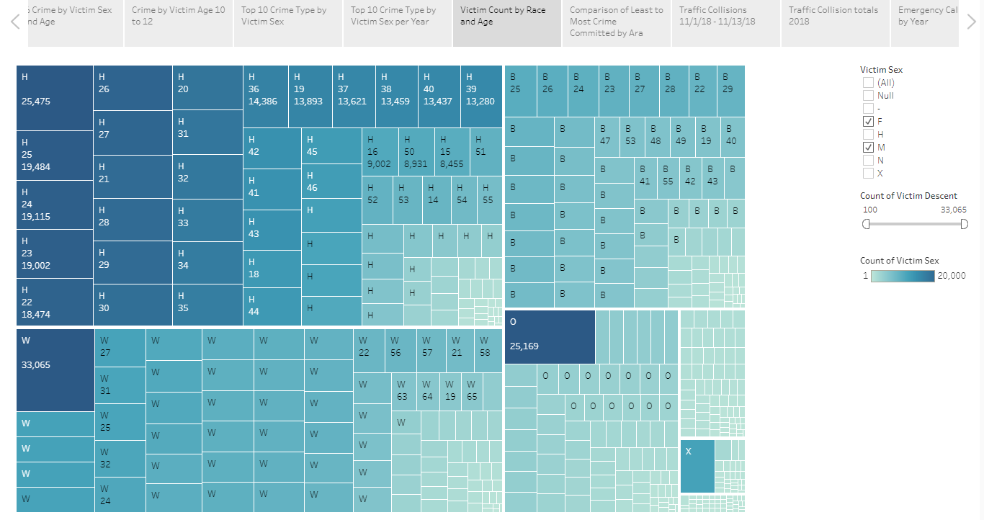
Victim Count by Race and Age

Slide 29
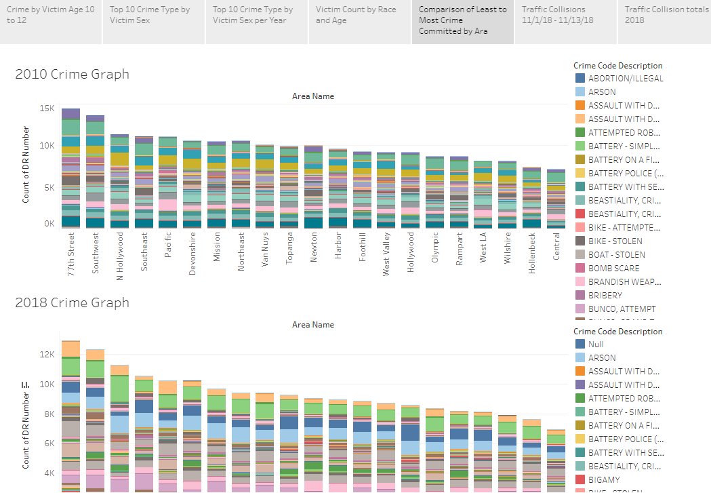
Most to Least Crime by Area 2010 v. 2018

Slide 30
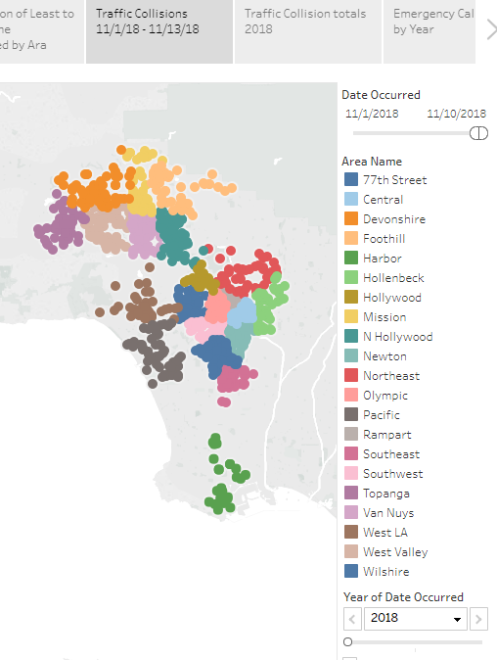
Traffic Collision Locations 2018

Slide 31
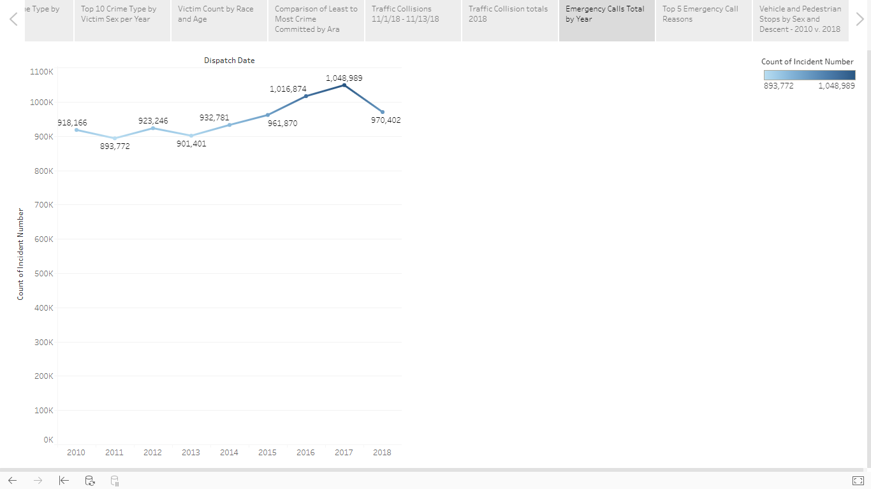
Emergency Calls Total by Year

Slide 32
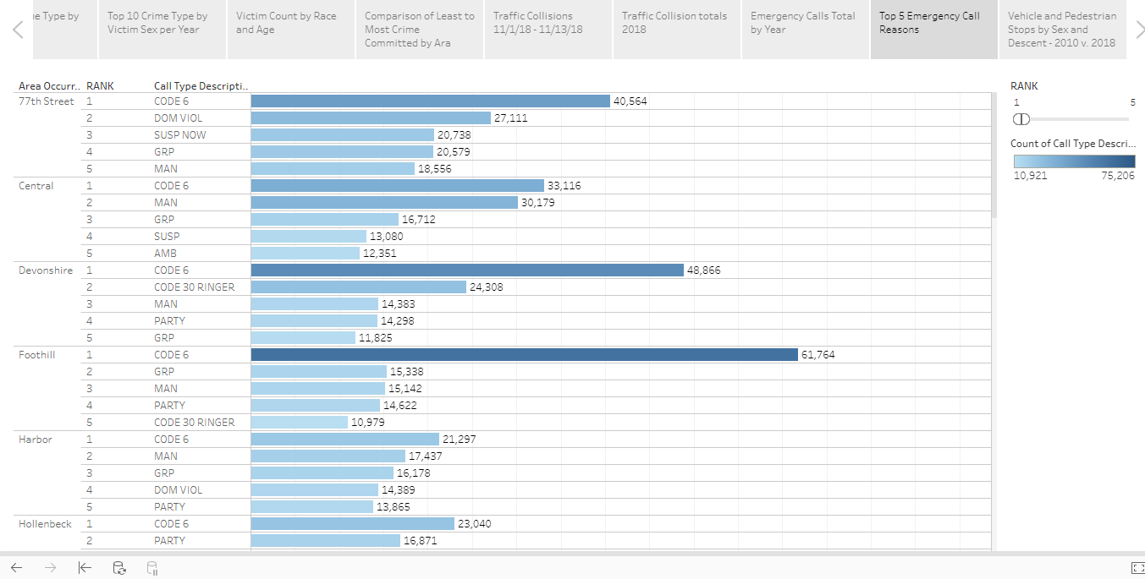
Top 5 Emergency Call Reasons

Slide 33
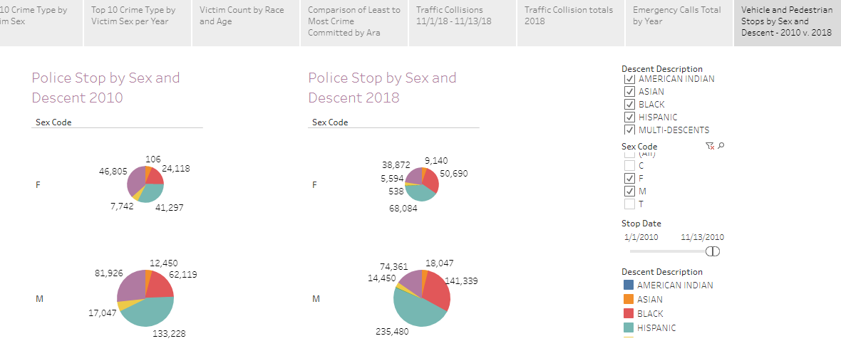
Vehicle and Pedestrian Stop
by Sex and Descent 2010 v. 2018

